Slide 1

KAFKA

Slide 2
CONTENTS
Create Producer and Consumer
Send messages from Producer
Producer API

Slide 3

Create Producer and Consumer
The central part of the KafkaProducer API is KafkaProducer class. The KafkaProducer class provides an option to connect a Kafka broker in its constructor with the following methods.
KafkaProducer class provides send method to send messages asynchronously to a topic. The signature of send() is as follows

Slide 4

ProducerRecord − The producer manages a buffer of records waiting to be sent.
Callback − A user-supplied callback to execute when the record has been acknowl-edged by the server (null indicates no callback).
KafkaProducer class provides a flush method to ensure all previously sent messages have been actually completed. Syntax of the flush method is as follows −

Slide 5

KafkaProducer class provides partitionFor method, which helps in getting the partition metadata for a given topic. This can be used for custom partitioning. The signature of this method is as follows −
It returns the map of internal metrics maintained by the producer.
public void close() − KafkaProducer class provides close method blocks until all previously sent requests are completed.

Slide 6
Simple Producer application
Before creating the application, first start ZooKeeper and Kafka broker then create your own topic in Kafka broker using create topic command.
After that create a java class named SimpleProducer.java and type in the following coding.

Slide 7
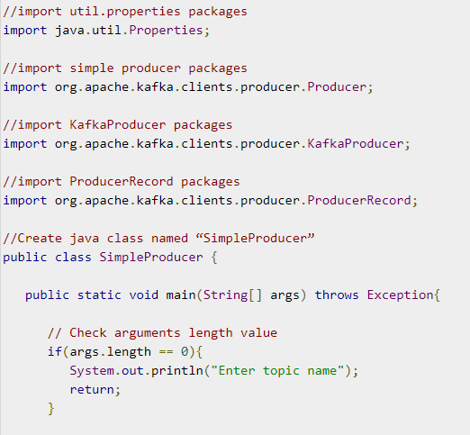

Slide 8
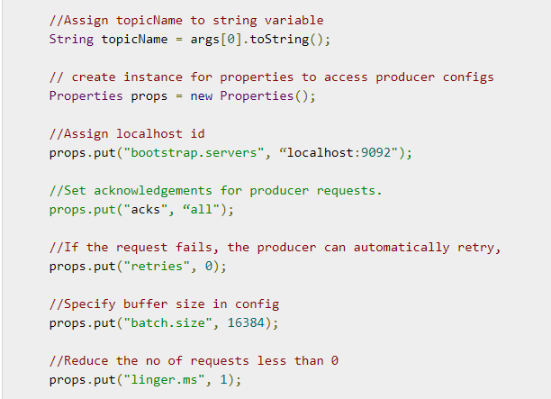

Slide 9
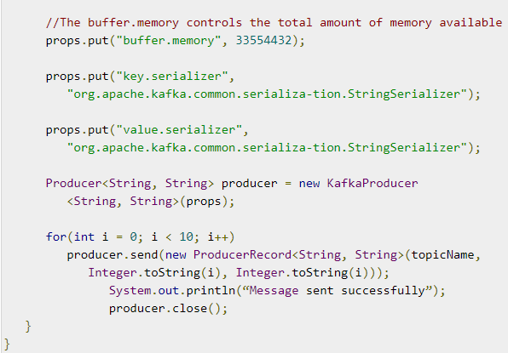

Slide 10
Compilation − The application can be compiled using the following command.
Execution − The application can be executed using the following command.

Slide 11
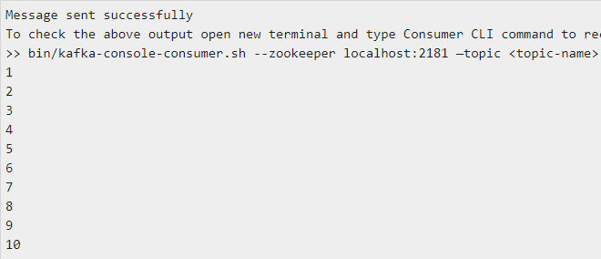
Output

Slide 12
SimpleConsumer Application
The producer application steps remain the same here.
First, start your ZooKeeper and Kafka broker.
Then create a SimpleConsumer application with the java class named SimpleConsumer.java and type the following code.

Slide 13
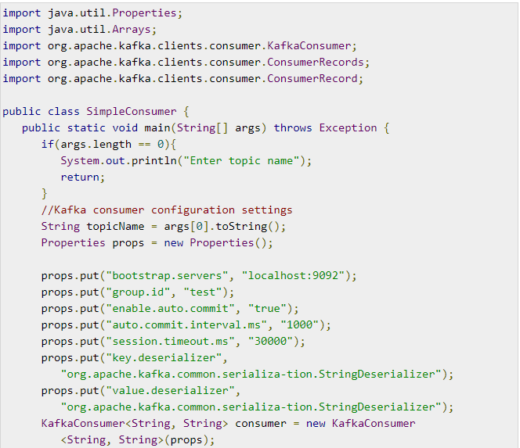

Slide 14
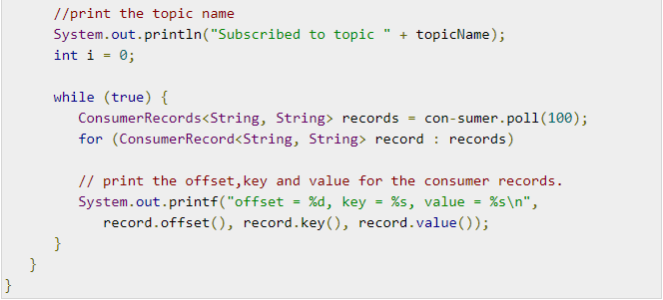

Slide 15
Compilation − The application can be compiled using the following command.
Execution − The application can be executed using the following command

Slide 16

Input − Open the producer CLI and send some messages to the topic. You can put the smple input as ‘Hello Consumer’.
Output − Following will be the output.

Slide 17
Send messages from Producer
In order to send data to the Kafka topic, a producer is required.
The role of the producer is to send or write data/messages to the Kafka topics.
In this section, we will learn how a producer sends messages to the Kafka topics.
There are following steps used to launch a producer:
Step1: Start the zookeeper as well as the kafka server.

Slide 18
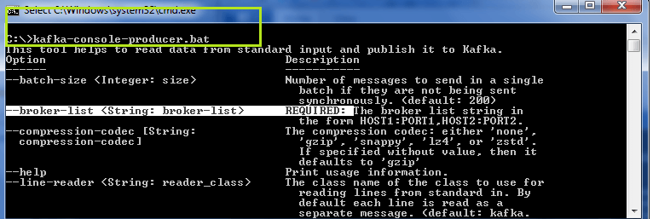
Step2: Type the command: 'kafka-console-producer' on the command line. This will help the user to read the data from the standard inputs and write it to the Kafka topic.

Slide 19
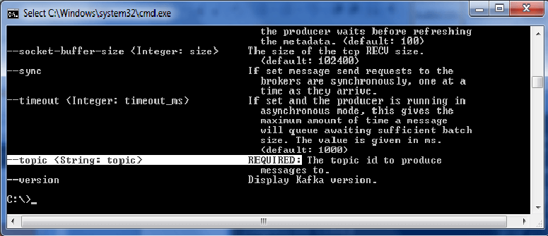

Slide 20
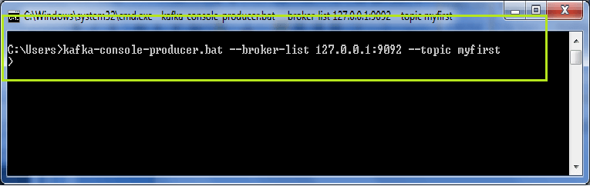
The highlighted text represents that a 'broker-list' and a 'topic id' is required to produce a message. It is because a producer must know the id of the topic to which the data is to be written.
Step3: After knowing all the requirements, try to produce a message to a topic using the command:
'kafka-console-producer -broker-list localhost:9092 -topic <topic_name>'. Press enter.

Slide 21
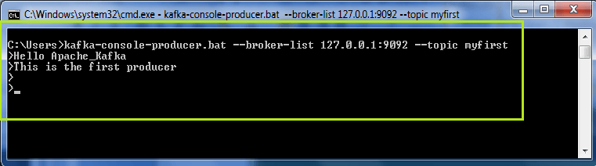
Here, 'myfirst' topic is chosen to write messages to.
A '>' will appear in the new line. Start producing some messages, as shown below:

Slide 22
Step4: Press 'Ctrl+c' and exist by pressing the 'Y' key.
So, in this way, a producer can produce/send several messages to the Kafka topics.
Producer with Keys
A Kafka producer can write data to the topic either with or without a key.
If a producer does not specify a key, the data will be stored to any of the partitions with key=null, else the data will be stored to the specified partition only.
A 'parse.key' and a 'key.seperator' is required to specify a key for the topic. The command used is:

Slide 23
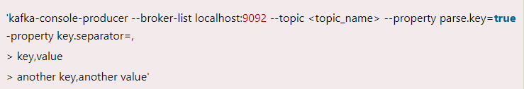
Here, key is the specific partition, and value is the message to be written by the producer to the topic.
When a topic does not exist?
Suppose the producer wants to send messages to a new topic that does not exist yet. In such a situation, a warning will appear, as shown in the below snapshot, after producing a message. It is just a warning.

Slide 24
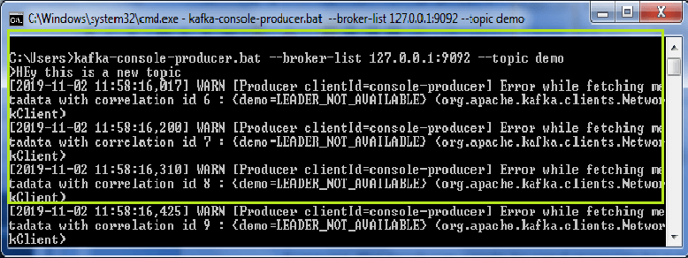
Why this warning?
The warning occurred because earlier the topic 'demo' didn't exist. But, as soon the producer wrote a message, Kafka somehow created that topic.

Slide 25
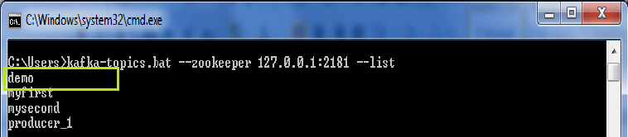
Although, no leader election held for this unexpected topic, 'LEADER_NOT_AVAILABLE' error could be seen.
But, for the next time, the producer can continue to write more messages as no warning will appear again. It is because the topic comes in the existing list now.
The users can check using the '-list' command, as shown below:

Slide 26
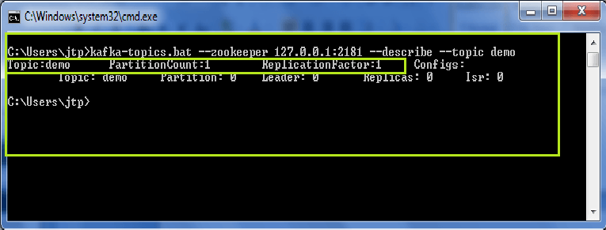
Describing the new topic
As such topics which are created directly by the producer grabs the default number of partitions and its replication factor as 1.
For example,

Slide 27
The topic 'demo' when described using the '-describe' command, gives the value of 'PartitionCount' and 'ReplicationFactor' as 1(default value).
Thus, it is always a better option to create a topic before producing messages to it.

Slide 28
Changing the Default Values
Follow the below steps to change the default values for the new topic:
Open 'server.properties' file using Notepad++, or any other text editor.
Edit the value of num.partitions=1 to a new value. Let it be 3. So, whenever such new topics are introduced, the number of PartitionCount and ReplicationFactor will be 3(whatever the user has set).
Save the file.
But, always create topics before.

Slide 29

Producer API
The central part of the KafkaProducer API is KafkaProducer class. The KafkaProducer class provides an option to connect a Kafka broker in its constructor with the following methods.
KafkaProducer class provides send method to send messages asynchronously to a topic. The signature of send() is as follows

Slide 30

ProducerRecord − The producer manages a buffer of records waiting to be sent.
Callback − A user-supplied callback to execute when the record has been acknowl-edged by the server (null indicates no callback).
KafkaProducer class provides a flush method to ensure all previously sent messages have been actually completed. Syntax of the flush method is as follows −

Slide 31

KafkaProducer class provides partitionFor method, which helps in getting the partition metadata for a given topic. This can be used for custom partitioning. The signature of this method is as follows −
It returns the map of internal metrics maintained by the producer.
public void close() − KafkaProducer class provides close method blocks until all previously sent requests are completed.

Slide 32
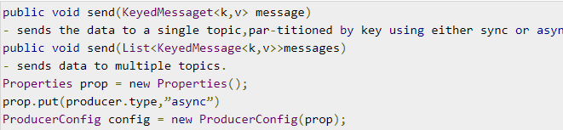
The central part of the Producer API is Producer class. Producer class provides an option to connect Kafka broker in its constructor by the following methods.
The Producer Class
The producer class provides send method to send messages to either single or multiple topics using the following signatures.

Slide 33
There are two types of producers – Sync and Async.
The same API configuration applies to Sync producer as well.
The difference between them is a sync producer sends messages directly, but sends messages in background.
Async producer is preferred when you want a higher throughput. In the previous releases like 0.8, an async producer does not have a callback for send() to register error handlers.
This is available only in the current release of 0.9.

Slide 34
Simple Producer application
Before creating the application, first start ZooKeeper and Kafka broker then create your own topic in Kafka broker using create topic command.
After that create a java class named Sim-pleProducer.java and type in the following coding.

Slide 38
Compilation − The application can be compiled using the following command.
Execution − The application can be executed using the following command.

Slide 39
Output

Slide 40
END OF SESSION
Q&A

